Slide 1
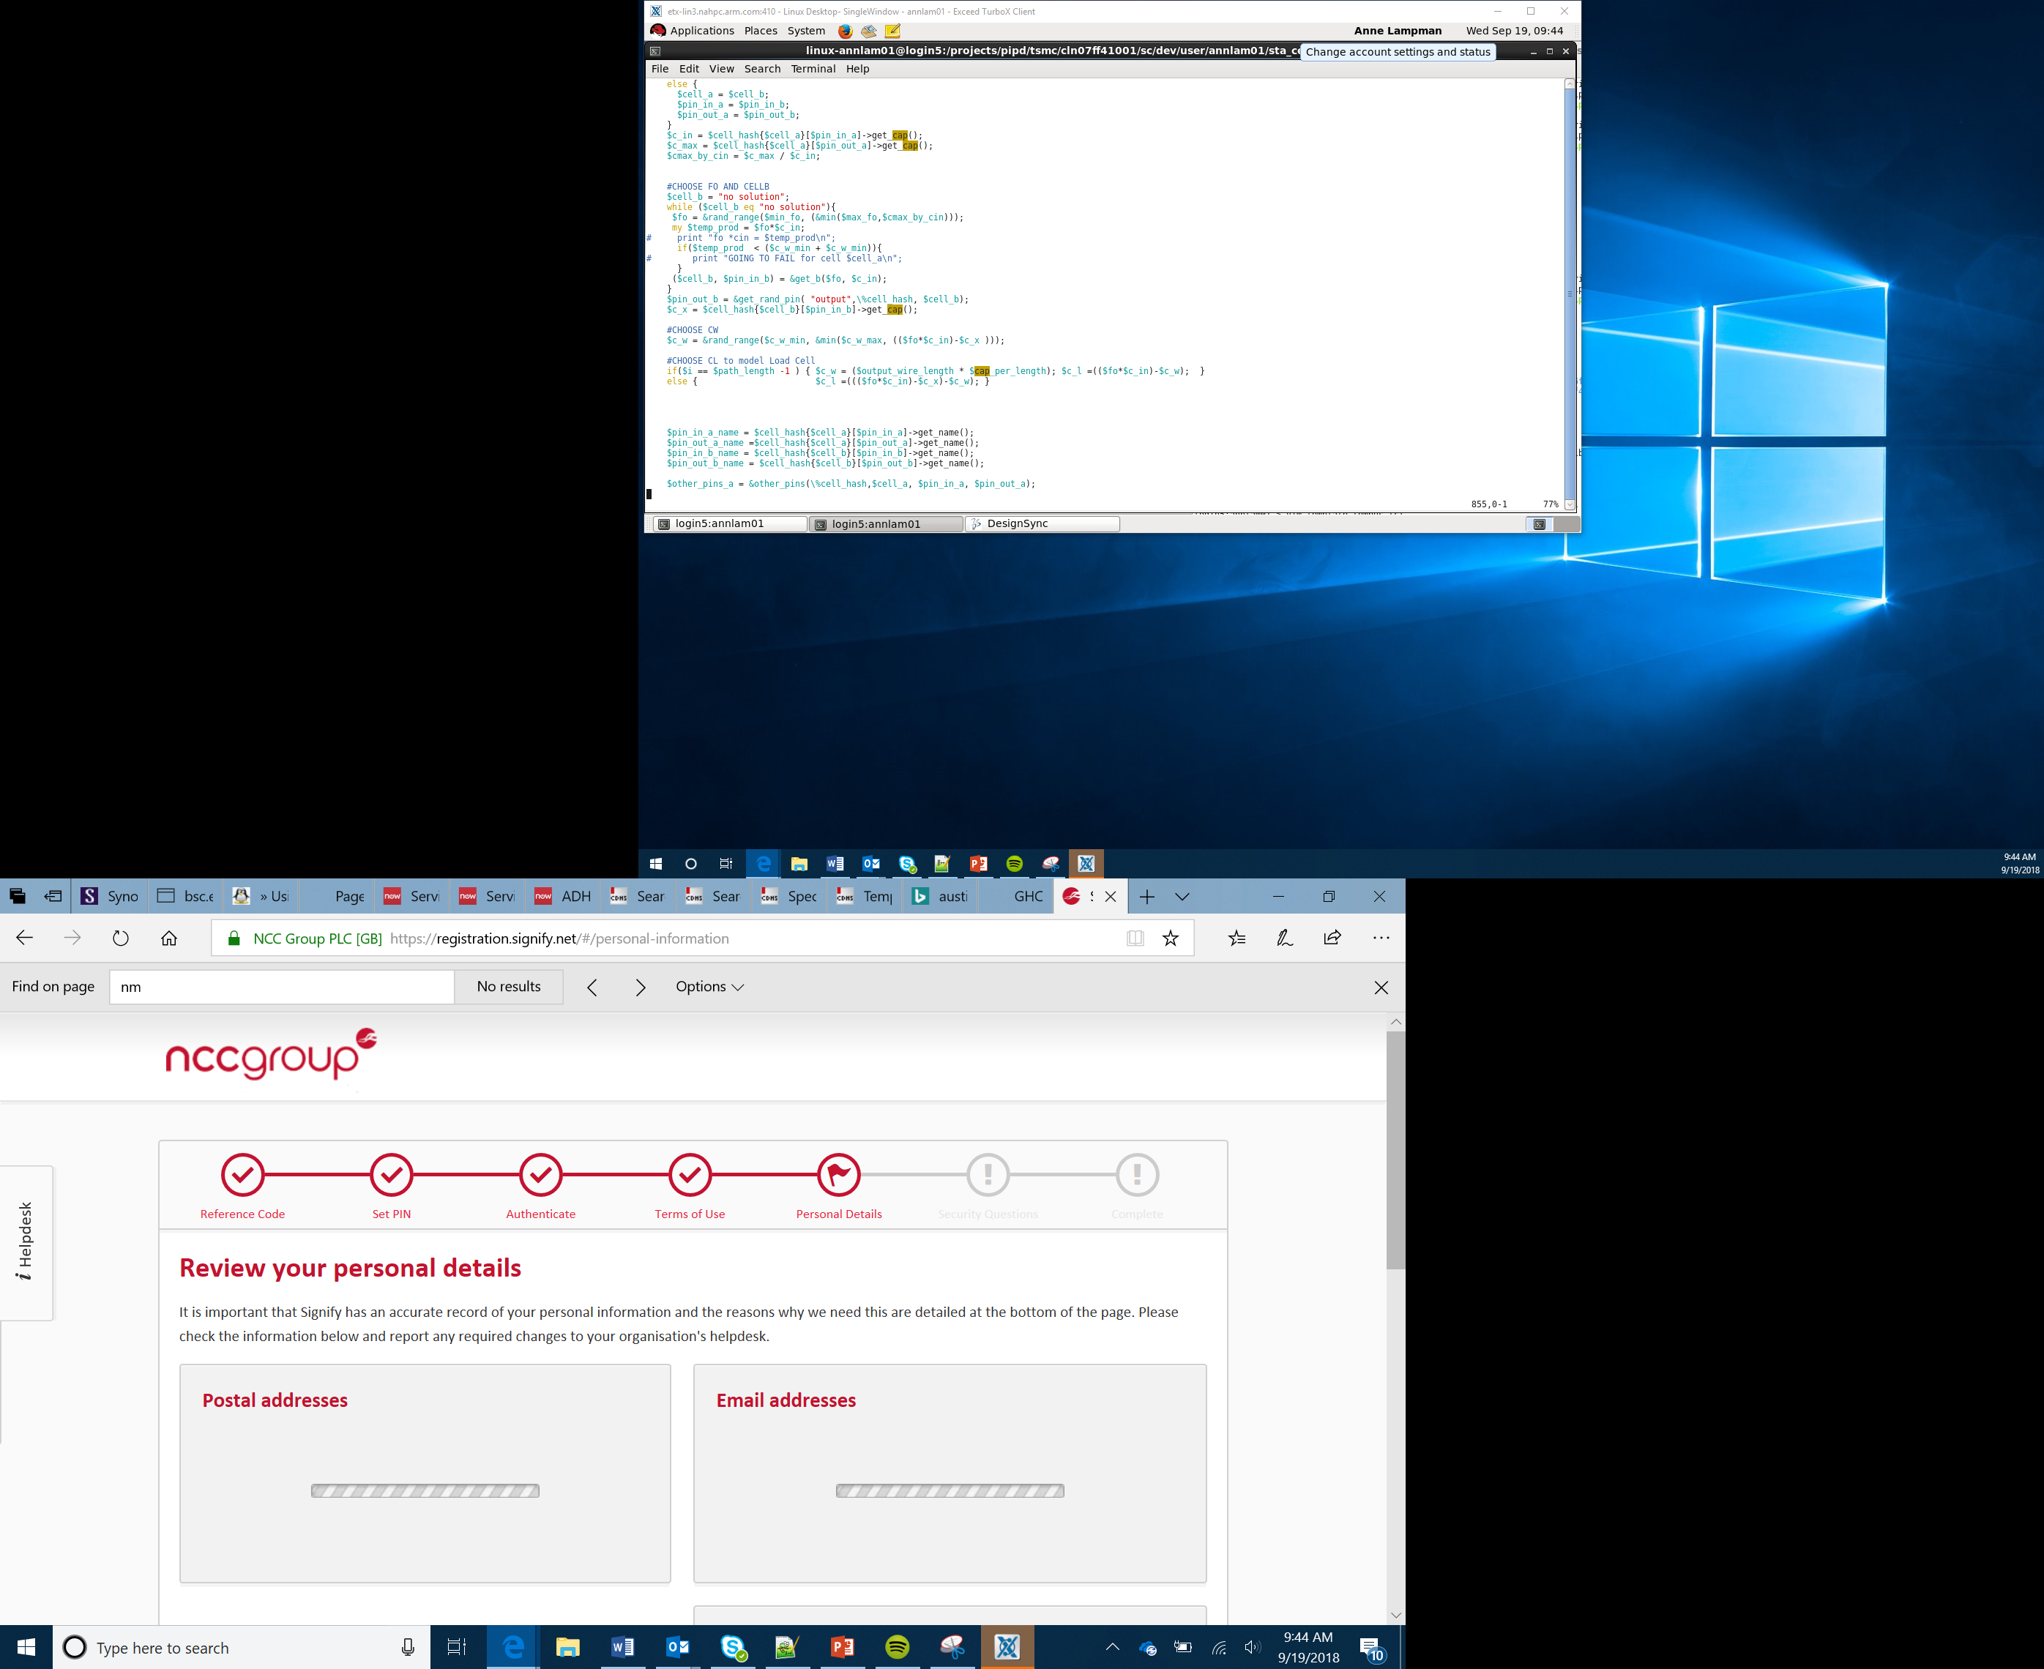

Smart Car
Part 2
Lesson 19

Slide 2
Objectives
Decide and design the car platform layout in terms of number of wheels
Decide and design how the car will turn or steer
Decide and design how the car will keep the occupants safe
Notes:
Introduce the objectives

Slide 3
Key Decisions
You might think that designing a car will be easy – after all, all cars are the same!
The only difference is ours will be smart!
The decisions you make now will have a huge impact on:
How well you car drives
How safe your car is
How your car looks
How well it sells
Notes:
Start the Learners thinking about how we see cars as all being the same, but there are many different design features that can be employed
Some of these choices will impact performance and safety but some may be down to cosmetics, fashion and trends

Slide 4
Key Decisions
The four key decisions to make first are:
How will you power your car – front wheels, rear wheels or all wheels?
How many wheels? 3, 4, 6 … more?
How will you turn/steer your car?
How will you keep your passengers safe?
Notes:
Introduce the four key decisions students will have to make first.

Slide 5
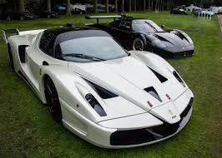
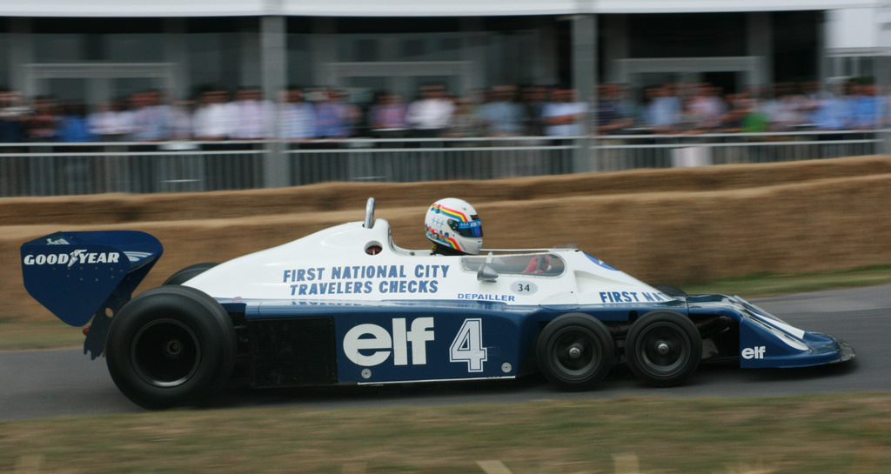
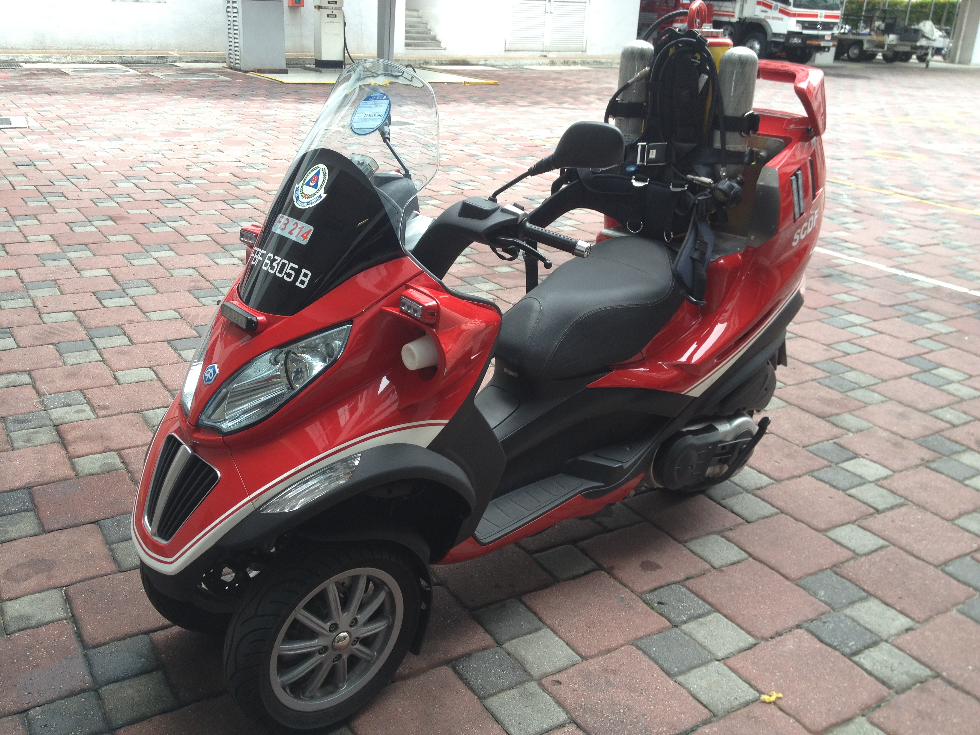
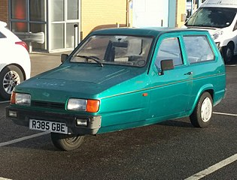
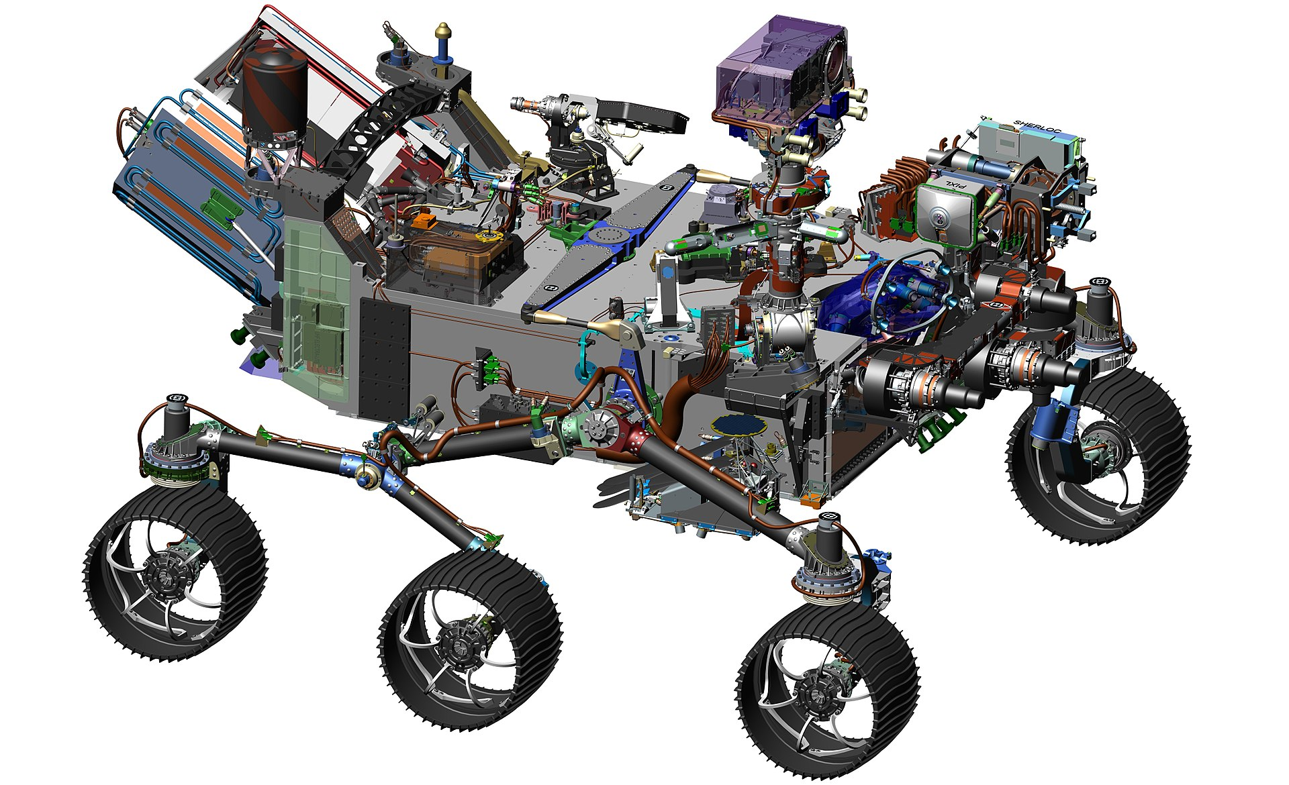
3, 4 or 6+ wheels
3-wheeled vehicles can look cool! – this may give your vehicle an edge with early adopters – Or sometime not!
Reducing the number of wheels or their size may reduce friction, becoming more energy efficient, but this might reduce stability
6 wheels may increase friction, but the stability will be increased and the turning circle could be much tighter
Will your vehicle use traditional wheels or ‘tank tacks’? How big will they be? What material?
Notes:
Discuss the impact of number of wheels and how this will influence style as well as how the power is applied and the vehicle is steered
Get the Learners to create a pros/cons table to help them make a decision

Slide 6
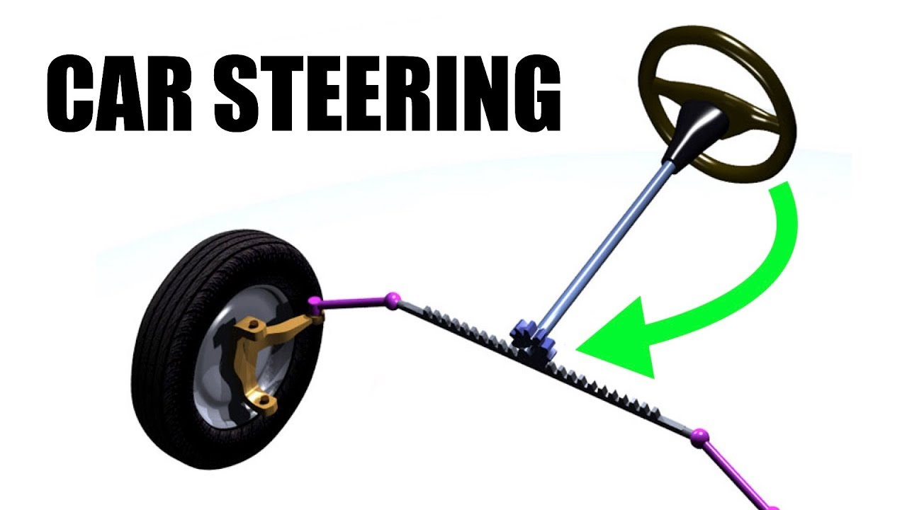
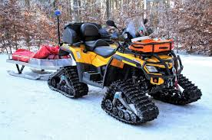
Steering
How are you going to control the steering?
Traditional rack and pinion system – Like a traditional car you turn the wheel to change direction
Single wheel steering – Stop one wheel and the vehicle will turn the way the powered wheel is rotating
Spin Steering – one side forward and one side in reverse the vehicle will turn on the spot
Tracked steering
Notes:
Remind Learners about how the Bit:Bot is steered, but this is not the only way
Get the Learners thinking about what might be the best way to steer their vehicle as well as which method will be the most practical to develop
Get the Learners to complete a pros/cons table for steering technology

Slide 7
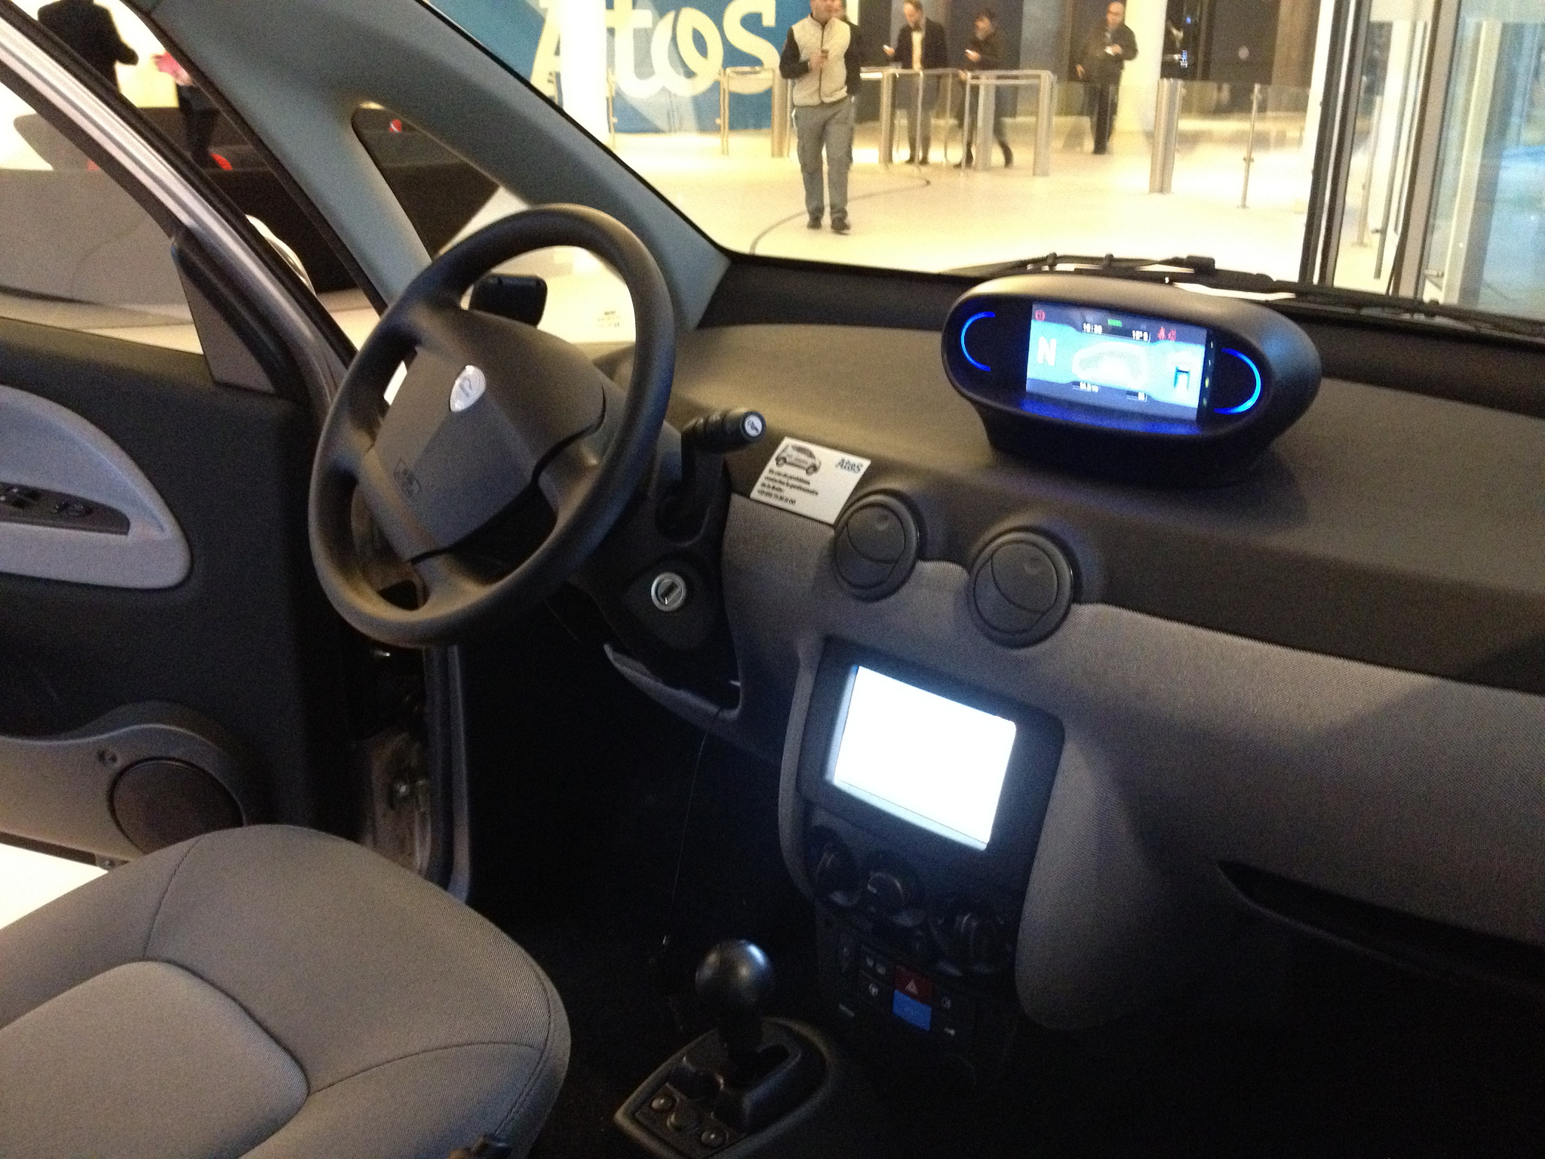
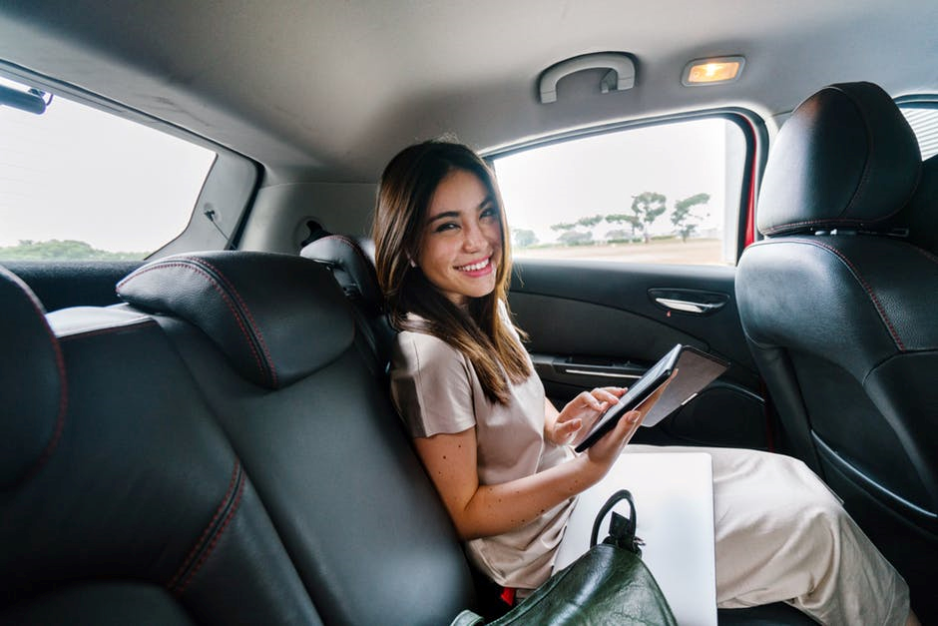
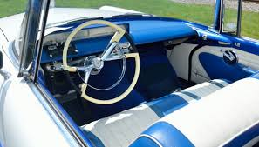
Passengers
Your vehicle won’t sell well if it’s a single seater – this is a family vehicle for the whole Egg family
You will need to consider the passenger compartment – how many seats will your vehicle support?
How will you keep the occupants safe?
Notes:
Get Learners to review the scenario.
This is for the whole Egg family – how many passengers will need to be driven around?
How will the cabin be laid out? Traditional 2 + 2? or single file 1+1+1+1?
Get Learners to discuss this in their teams and record their decision with reasoning

